Slide 1
INTERSTAT: Metadata Quality Assurance (MQA) - Notes
General Assembly meeting - 4 October 2022
Francesca D’Agresti (Engineering Ingegneria Informatica SpA)

Slide 2

Metadata Quality Assurance
The official portal for European data
MQA is a tool developed by the data.europa.eu consortium to study the quality of metadata collected by data.europa.eu.
It is intended to help data providers and data portals verify the quality of metadata and receive suggestions for improvements. The results are presented via the MQA and are also available as a download.
Objective:
The MQA survey addresses the following issues:
Compliance with DCAT-AP (v2.0.1)
and related derivatives
Dissemination of non-mandatory information for the DCAT-AP specification
Accessibility of data referenced in the metadata via the login and download URL
Automatic readability of the referenced data
Use of Licenses
What is the quality of metadata for public sector data and what are the main obstacles to achieving better quality?

Slide 3
Metadata Quality Assurance
MQA is based on the following assumptions
If there are errors in the source metadata
these can falsify the overall result
MQA provides a validation service to limit this potential for error
it can be used by data providers to validate their metadata (1 -2 -3)
Test results are stored in the form of a Data Quality Vocabulary (DQV)
DQV is a W3C specification used to describe the quality of a data set.
Since accessibility can be volatile, repeat checks are required for access and download URLs.
The MQA periodically checks the accessibility of all distributions
(1) DCAT-AP SHACL Validator: https://data.europa.eu/mqa/shacl-validator-ui/
(2) DCAT-AP SHACL Validator API: https://data.europa.eu/api/mqa/shacl/index.html
(3) Example of Validation test

Slide 4
Metadata Quality Assurance
MQA is based on the following assumptions
Use of non-mandatory fields DCAT-AP
Filling in the required DCAT-AP fields alone is not enough to provide high quality metadata.
For this reason, the evaluation also checks fields that are not specified as mandatory according to the DCAT-AP.
Identical content for multiple distributions
** This definition relates to how datasets are valued in the MQA (a "best practice") but should not be considered as the standard definition of distributions.
If a dataset contains more than one distribution, all distributions are identical in content,
differing only in the representation of the data.
For example, a dataset may have two distributions, one offering the data in PDF format and the other offering the identical data as machine-readable RDF/XML.

Slide 5
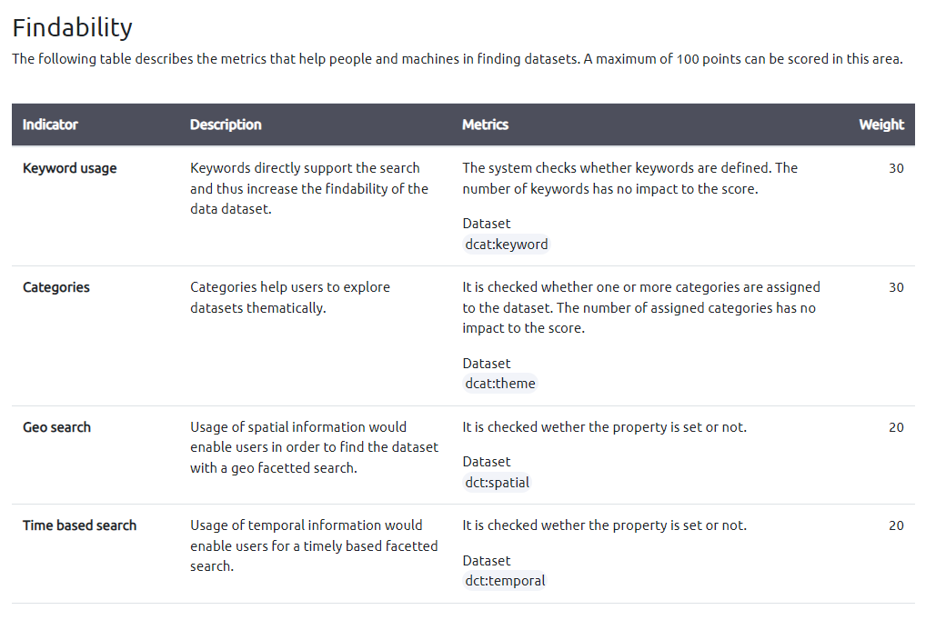
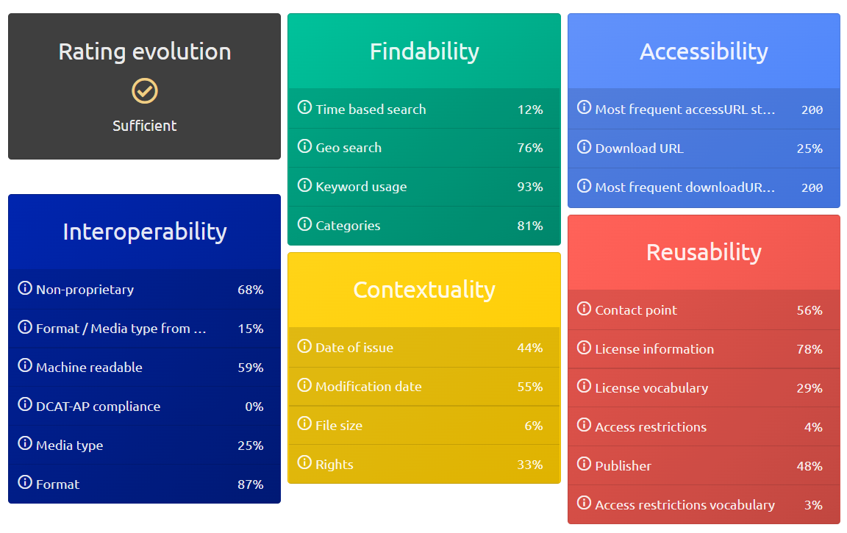
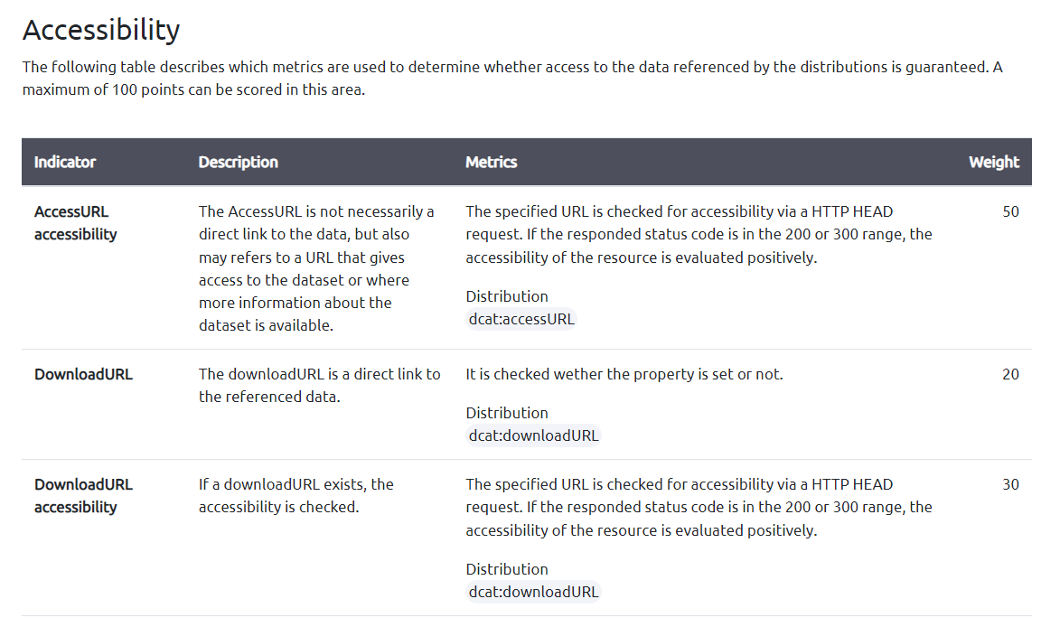
Metadata Quality Assurance
Parameters checked by the MQA tool to assess compliance
Tool

Slide 6

Thank you!

